Slide 1
Spring Boot StandAlone Application

Slide 2
Spring Boot StandAlone Application

Slide 3
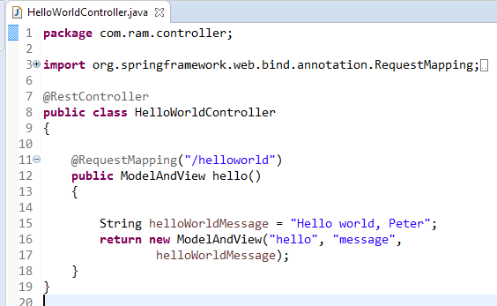
Spring Boot web application example
As request first goes to dispatcherServlet and it redirects to the controller class.
Here @Controller depicts that this is our controller class.
@RequestMapper is used to map incoming HTTP request to handler method(hello()).So hello() method of HelloWorldController.java will handle GET request from dispatcher
So when we have url of http://localhost:8080/helloworld - hello() method will be called

Slide 4
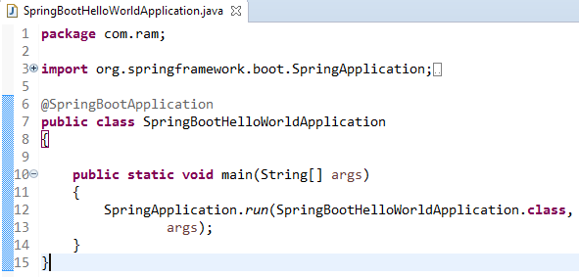
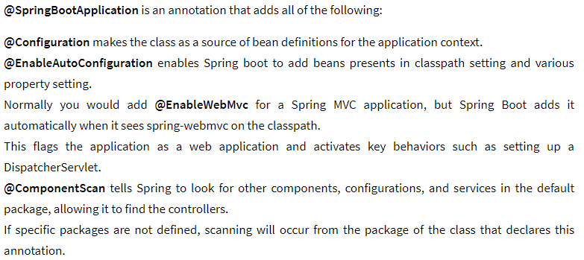
Spring Boot web application example

Slide 5

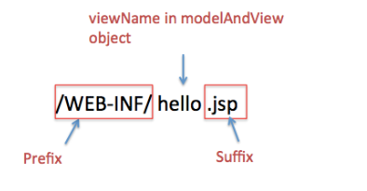
Spring Boot web application example

Slide 6
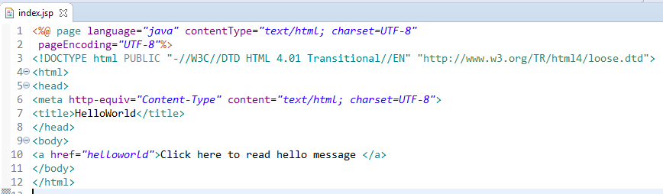
Spring Boot web application example

Slide 7
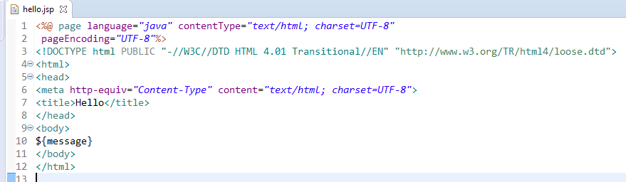
Spring Boot web application example
Create hello.jsp in /WEB-INF/ folder

